Slide 1
ITS HR/Payroll
Session 43: HR/Payroll Enhancements
Presented by Frans Pelser

Slide 2
DISCLAIMER
This presentation is only a summary of some of Adapt IT’s products, features and their latest developments. Adapt IT only intends for the information to give you an overview, and not a complete and comprehensive statement that necessarily suits your purposes.
Adapt IT reserves the right to change any information contained in this presentation and is not responsible for any loss that results from inaccuracies in the information. You may not distribute or reproduce the information without Adapt IT’s written permission.

Slide 3
Table of contents
The Team
Main Factors and Focus
HR/PR Dev Team effort
System Changes 2024
Possible Items in Roadmap
Explore the Future

Slide 4
The Team

Slide 5
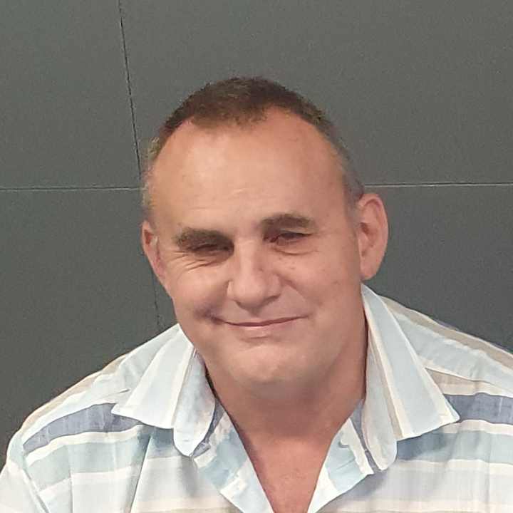
WE have
Elsabe, Johana, Jackie, Allie, Lucia, Saroj Pictures to add: Vikesh and Base

Slide 6
Main Factors and Focus

Slide 7
Main Factors and Focus
Management / Reporting Structures and Staff
White Space Program
Initial Focus: Functionality not used
Uncovered:
HR/PR Staff turnover at clients
Influence of HR Processes on Payroll (Session 49)
Scope of upskilling required
Internal Admin Systems to organize work
Notes:
Management
Slight change in Adapt IT Education Team structure
P/O not yet replaced
New BA and Support Engineer onboarded
Internal Admin Systems
Attempt to use several solutions, not happy with the outcome
Still in flux
Next Focus
Available features not used – White Space Program still runs to Mid 2025
Feedback from WSP

Slide 8
HR/PR Dev Team effort

Slide 9
HR/PR Dev Team effort

Slide 10
System Changes 2024

Slide 11
System Changes 2024
Big Items
Modernization
Minor Improvements
Industrial Relations (Session 48)
COIDA, UIF, Skills (Session 53)
API to Sygnify (Performance M)
Automatic Birthday Wishes
iEnabler Security Upgrade
New ADF S/Rec {PBOP-15/16}
Download of Files iso. ftp
Adjust iEnablers to latest MS Edge Browser
E-Recruitment
Leave and Leave iEnabler
Payroll / Tax Certificates
iEnabler Claims (Stabilisation)
iEnabler Overtime (Stabilisation)

Slide 12
Possible Items in Roadmap

Slide 13
Possible Items in Roadmap
Re-work Skills Development
On-line Declaration of Interest
iEnabler Ad-Hoc and S&T Claims Workflows
SA Statutory Changes once new SARS BRS is available

Slide 14
Explore the Future

Slide 15
Explore the Future
Session 46: Flexible reporting of combined HR/Leave and Payroll Information with Dashboards
Session 50: Employment Equity Planning
Refocus with Plugins and API‘s to External Systems

